Slide 1

Audio to Text Translation
GEN AI AND LLM

Slide 2
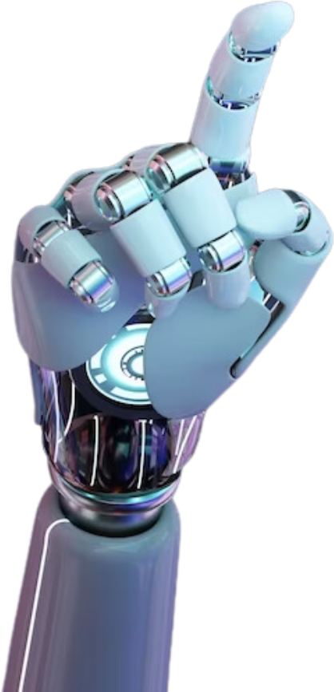

Introduction
The Audio-to-Text Translation project is a web application that converts audio files into text and, if necessary, translates the transcribed text into English. This application leverages machine learning models and APIs to deliver accurate transcriptions and translations, making it useful for various applications such as transcribing lectures, translating spoken content, and aiding in language learning.

Slide 3

Key Features
Audio File Upload: Users can upload audio files in mp3 format directly through the web interface.
Language Detection: The application automatically detects the language spoken in the audio file using the Whisper model.
Transcription: The detected language is used to transcribe the audio into text accurately.
Translation: If the transcribed text is not in English, the application uses OpenAI's GPT-3 model to translate it into English.
Text Output: Both the transcription and translation (if applicable) are displayed on the web interface and saved as text files.

Slide 4


Technologies Used
Technologies Used
Streamlit: A web application framework for creating interactive and user-friendly web applications in Python.
Whisper: An advanced deep learning model for automatic speech recognition (ASR) capable of transcribing speech into text and detecting the language of the speech.
OpenAI GPT-3: A powerful language model used for translating text from one language to another.

Slide 5
How it Works
User Uploads an Audio File: The user uploads an mp3 audio file through the Streamlit interface.
Audio Processing:
The uploaded file is saved temporarily.
The Whisper model loads and processes the audio to generate a log-Mel spectrogram.
Language Detection: Whisper's language detection feature identifies the language spoken in the audio.
Transcription: The audio is transcribed into text using Whisper, considering the detected language.
Translation:
If the detected language is not English, the transcribed text is sent to OpenAI's GPT-3 for translation into English.
Display and Save:
The transcribed text and its translation (if applicable) are displayed on the Streamlit interface.
The transcription is saved as a text file for download.

Slide 6
Potential Applications
Education: Transcribe and translate lectures, seminars, and webinars for students and educators.
Business: Convert meeting recordings and presentations into text for documentation and multilingual communication.
Accessibility: Assist people with hearing impairments by providing text versions of spoken content.
Language Learning: Help learners by providing transcriptions and translations of audio content in various languages.

Slide 7
Conclusion
The Audio-to-Text Translation project helps convert audio into text and translate it. By automating these processes, the application makes it easier for users to access and understand spoken content in different languages, broadening the scope of communication and learning.

Slide 8


About Us
jOE jOSEPH - PES2UG22CS237

Slide 9





About Us
PES2UG22CS237 - Joe Joseph
PES2UG21CS618 - Y Teresha
PES2UG21CS345 - Nishat M

Slide 10
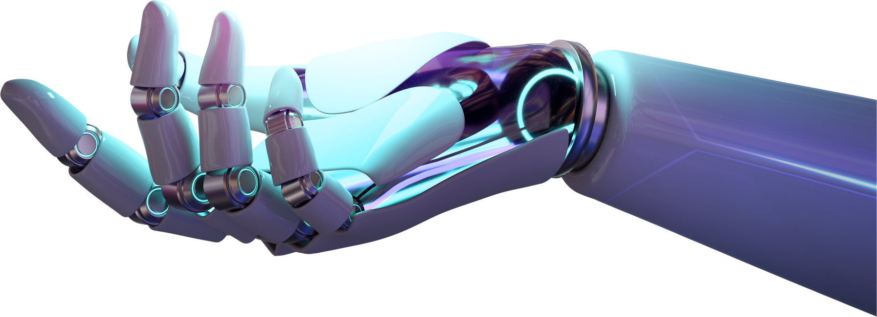
Thank You

